Slide 2
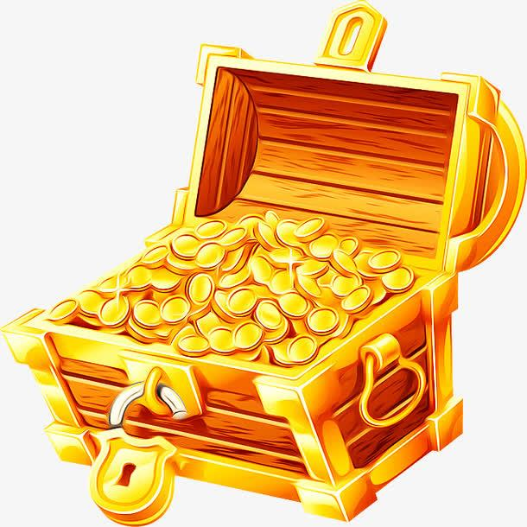
1 point
2 points

Slide 3
1. When is the Final Draft due?
A. 2 pm Tuesday, 16th March, Week 3
B. 3 pm Wednesday, 17th March, Week 3
C. 4 pm Thursday, 18th March, Week3
A

Slide 4
2. You only need to argue why art-based subjects need to be prioritized in high schools.
A．True
B．False
B

Slide 5
3. How many people will be in a group working together to complete the SIC?
A. 2 B. 3 C. 4 D. 5
B

Slide 6
4. This assignment contributes towards your mark for this module.
A. True
B. False
B

Slide 7
5. What is the correct word count range for the essay?
A. 220-330 B. 450-500
C. 540-660 D. 650-700
C

Slide 8
6. How many sources from the Recommended Reading List must you include?
A. No more than 3 sources
B. No more than 2 sources
C. At least 4 sources
D. At least 3 sources
D

Slide 9
7. Referencing in EAP020 means that you need to…?.
A. Include in-text citations and a complete reference list at the end of your essay.
B. Include quotation marks ‘…’ around directly quoted material.
C. Use the Harvard referencing system when citing information.
D. All of the above.
D

Slide 10
8. When is the Source Integration Chart due?
Tuesday 3pm, Week 3
Wednesday 3 pm, Week 3
Tuesday 2pm, Week 2
Wednesday 3pm, Week 2
C

Slide 11
9. Where do you submit the Source Integration Chart?
Turn it in to your lecturer in class
Submit it on LMO
B

Slide 12
10. As this assignment is not marked, plagiarism will not be penalized.
True
False
B

Slide 13
11. You are not allowed to use extra/additional sources other than those given to you.
True
False
A

Slide 14
12. Page numbers should be included in your work.
True
False
A

Slide 15
13. There are _____ sources that you can use to write your essay.
A. 3 B. 4 C. 5 D. 6
B

Slide 16
14. You should develop and support your response with_____.
A. Details
B. Explanations
C. Examples
D. All of the above
D

Slide 17
15. If you have to use direct quotation ‘…’, you should quote no more than _____ words.
A. 20 B. 25 C. 30 D. 35
B

Slide 18
16. You will individually write your first draft of the essay to bring to class in Week 3 for peer review.
True
False
A

